Slide 1
he Analytics Team Sprocket Central Pty Ltd Data analytics approach Bakhrom Mansurov

Slide 2
Agenda
1. Introduction
2. Data Exploration
3. Model Development
4. Interpretation

Slide 3
Identify and Recommend Top 1000 Customers to Target from Dataset
Outline of Problem
Sprocket Central is a company that specializes in high-quality bikes and cycling accessories.
Their marketing team is looking to boost business sales by analyzing provided datasets.
Using the 3 datasets provided the aim to analyze and recommend 1000 customers that Sprocket Central should target to drive higher value for the company.
Contents of Data Analysis
‘New’ and ‘Old’ Customer Age Distributions
Bike related purchases over the last 3 years by gender
Job industry distributions
Wealth segmentations by age category
Number of cars owned and not owned by state
RFM analysis and customer classification
This will be done with three phases of: Data Exploration, Model Development and Interpretation.

Slide 4
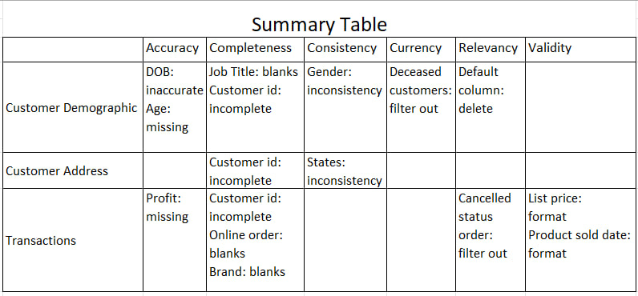
Data exploration Data quality Assessment ‘and clean up’
Key Issues for Data Quality Assessment
Accuracy: Correct Values
Completeness: Data fields with values
Consistency: Values up to date
Relevancy: Data items with Value Meta-data
Validity: Data Containing Allowable Values
Uniqueness: Records that are Dublicated

Slide 5
Data exploration ‘new’ and ‘Old’ customer age Distribution
Most customers are aged between 40-49 in ‘New’. In ‘Old’ majority of customers are aged between 40-49 also.
The lowest age groups are under 20 and 80+ for both ‘New’ and ‘Old’ customer lists.
The ‘New’ customer list suggests that age groups 20-29 and 40-69 are most populated.
The ‘Old’ customer list suggest 20-69
There is a steep drop of customers in the 30-39 age group in ‘New’

Slide 6
Data exploration Bike related purchases for the past 3 years by gender
Over the last three years about 50% of bike related purchases were made by females and about47% of purchases made by males. Approximately 2% were made by unknown gender.
Numerically, females purchases about 28000 more than males
Females make up majority of bike related sales

Slide 7
Data exploration Job industry distribution
20 of ‘New’ Customers are in Manufacturing and Financial Services.
The smallest number of customers are in Agriculture Telecommunications at 3%
Similar pattern in ‘Old’ customer list, at 20% and 19% in Manufacturing and Financial Services respectively

Slide 8
Data exploration Wealth segmentation by age category
In all age categories the largest number of customers are classified as ‘Mass Customer’
The next category is the ‘High Net Worth’ customers
The ‘Affluent Customer’ can outperform the ‘High Net Worth’ customer in the 40-49 age group.

Slide 9
Data exploration Number of cars owned and not owned by state
NSW has the Largest amount of people that do not own a car. NSW seems to have a higher number of people from which data was collected.
Victoria is also split quite evenly. But both numbers are significantly lower than those of NSW.
QLD has a relatively high numbers of customers that own a car.

Slide 10
Model development rfm analysis and customer classification
RFM analysis is used to determine which customers a business should target to increase it’s revenue and value.
The RFM (Recency, Frequency, and Monetary) model shows customers that have displayed high levels of engagement with the business in the three categories mentioned.

Slide 11
Model development scatter-plot based on rfm analysis
The chart shows that customers who purchased more recently have generated more revenue, than customer who visited a while ago.
Customers from recent past (50-100 days) also show to generate a moderate amount of revenue.
Those who visited more than 200 days ago generate low revenue.

Slide 12
Model development scatter-plot based off rfm analysis
Customer classified as “Platinum Customer”, “Very Loyal”, and “Becoming Loyal” visit frequently, which correlated with increased revenue for the business
Naturally, there is a positive relationship between frequency and monetary gain for the business.

Slide 13
Model development scatter-plot based off rfm analysis
Very low frequency of 0-2 correlated with high recency values i.e. More than 250 days ago.
Customers that have visited more recently (0-50 days) have a higher chance of visiting more frequently (6+)
Higher frequency has a negative relationship with recency values. Such that very recent customers are also frequent customers.

Slide 14
Model development Customer Title definition list with rfm values assigned
Rank | RFM Value | Customer Title | Description
1 | 444 | Platinum Customer | Most recent buy, buys often, most spent
2 | 434 | Very Loyal | Most recent , buys often, spends large amount of money
3 | 422 | Becoming Loyal | Most recent, bought more than once, small amount spent
4 | 411 | Recent Customer | Most recent, never bought before, very low amount of money spent
5 | 324 | Potential Customer | Bought recently, law frequency, most spent
6 | 312 | Late Bloomer | Bought recently , very low frequency, very low amount of money spent
7 | 224 | Loosing Customer | Purchases was a while ago, low frequency, most spent
8 | 212 | High Risk Customer | Purchases was a while ago, very low frequency, small amount spent
9 | 124 | Almost Lost Customer | Very low recency, low frequency, but high amount spent
10 | 121 | Evuasive Customer | Very low recency, low frequency, very low amount of money spent
11 | 111 | Lost Customer | Very low RFM

Slide 15
Model development customer title distribution in dataset

